Slide 1
Meeting 27

Slide 2
Tasks
Look into the gamma distribution to improve the generation of annual maxima
Make function and plot to get wet and dry spells distributions
Try to understand why “good” daily annual maxima rainfall translate to “bad” daily annual maxima flow

Slide 3
Gamma distribution
Previously, use MLE to get amount model parameters (a & b)
My attempt this week, use Method of moment. >>> it does improve the model significantly.

Slide 4
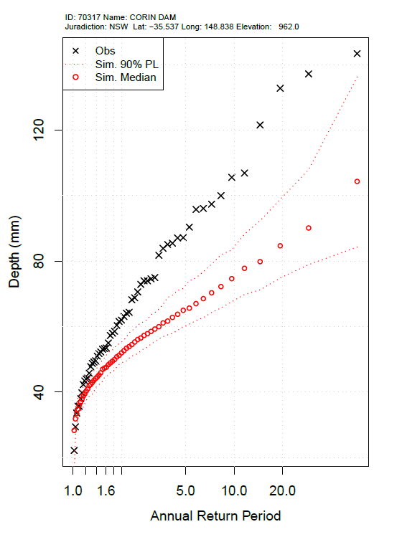
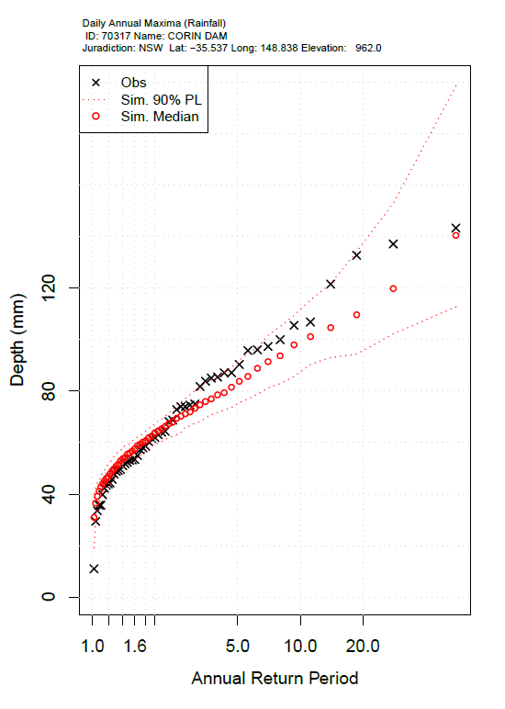
MLE vs MoM
MLE
MoM

Slide 5
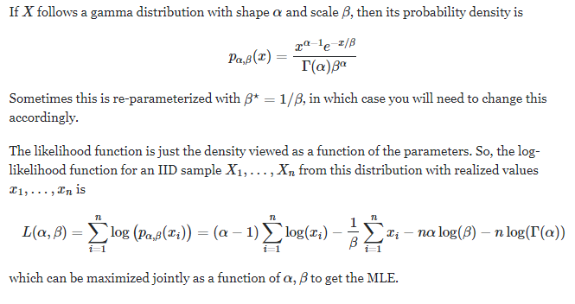

Potential issue with MLE method
From the net
Previous code
Or

Slide 6
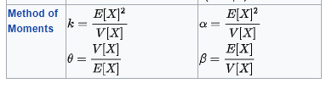
Potential issue with MLE method
From the net
Previous code
Or
Issue could come from the way that I setup Optim >> could not get optimal b
Here, b is rate

Slide 7
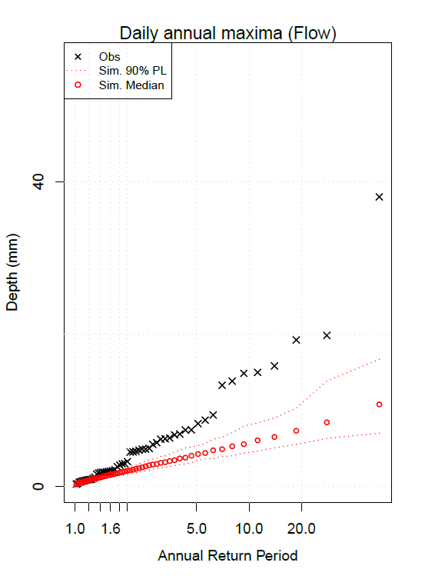
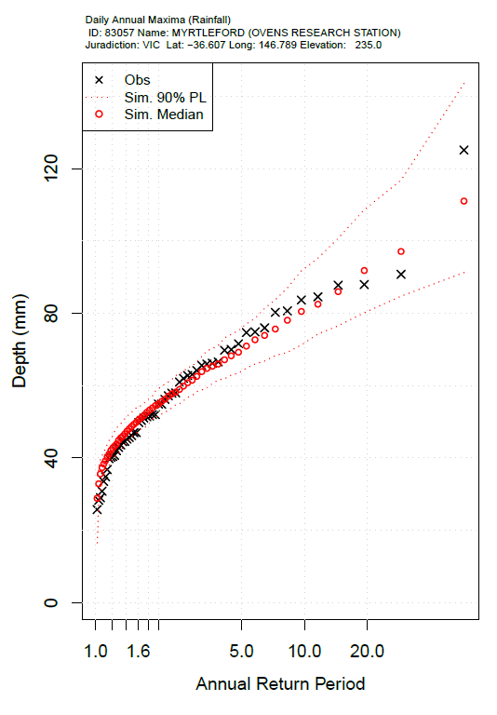
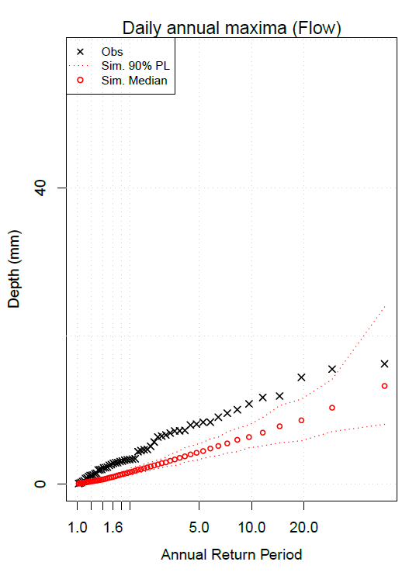
Spotted a pattern
“good” annual maxima rainfall does not translate to “good” annual maxima runoff
Example 1
Example 2

Slide 8
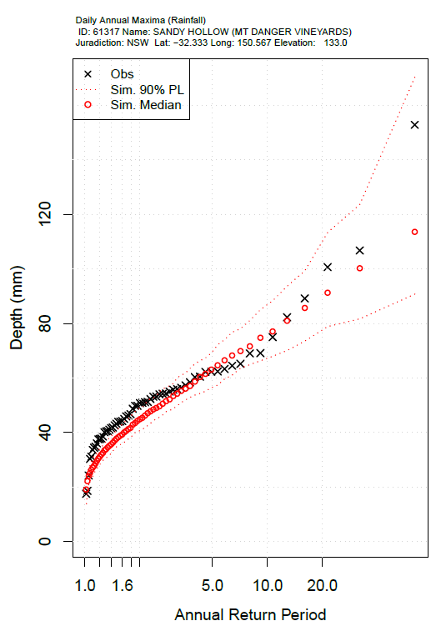
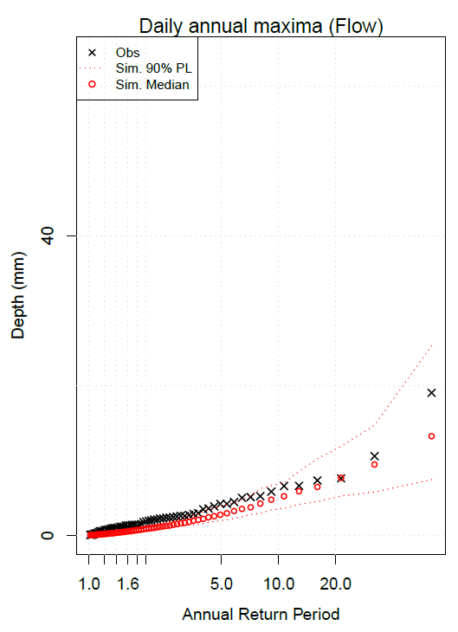
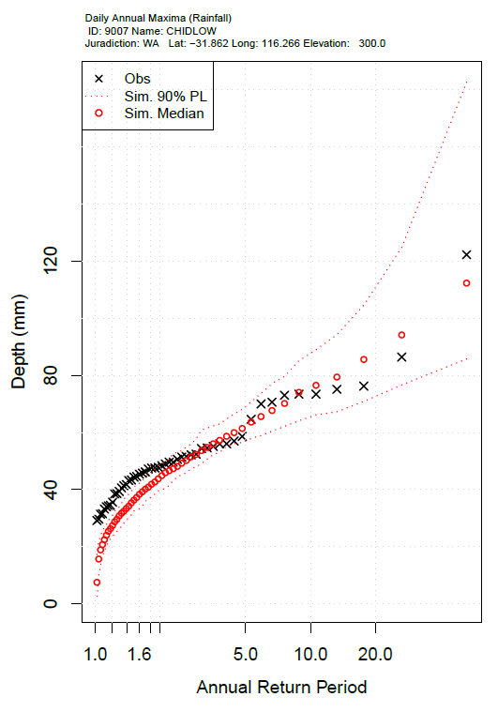
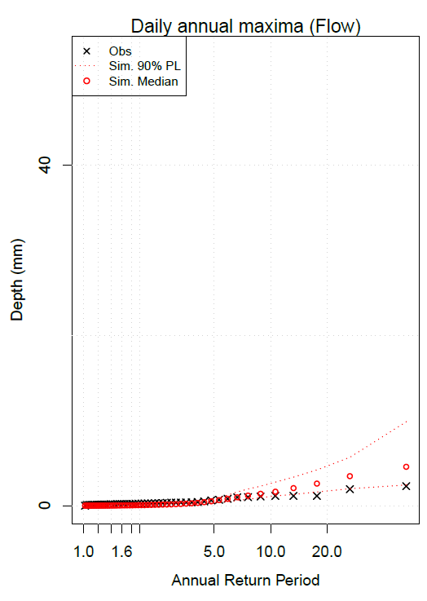
Spotted a pattern
And for some sites “good” annual maxima rainfall does translate to “good” annual maxima runoff
Example 3
Example 4

Slide 9
Spotted a pattern
“good” annual maxima rainfall does not translate to “good” annual maxima runoff
Likely to happen for smaller catchment
130 km^2
138 km^2
Example 1
Example 2

Slide 10
Spotted a pattern
And for some sites “good” annual maxima rainfall does translate to “good” annual maxima runoff
Likely to happen for larger catchment
670.8 km^2
593.8 km^2
Example 3
Example 4

Slide 11
Plan and questions
What else could I look into to help understand the translation between rainfall annual maxima and flow annual maxima? – calculate more rainfall stats, e.g. 3-day, 5-day maxima.
Plot catchment map
Get distance from rainfall station to catchment outlet
Once distance from rainfall station to outlet is known, should I try rerun the sim with more rainfall stations for a site (i.e. average of 3 stations) ?
Think and plan on the hydrological calibration. whether it is feasible.
If the hydrological calibration does not work, what is another direction that I can look into?

Slide 12
Meeting 28

Slide 13
Tasks
fix and update on occurrence and amount model
>>> can identify some cases where good modelled rainfall translate to bad modelled streamflow.
Optimise with SCEoptim
Attempt to shuffle monthly rainfall

Slide 14
Using SCEoptim with SSE as objective function
Trial 1: lowerBound=rep(0,48); upperBound=rep(0.99,48)
Trial 2: lowerBound[1:24]=0; lowerBound[25:48]=1e-10
upperBound[1:24]=1; upperBound[25:48]=Inf
Trial 3: Boundaries same as Trial 2, SSE=SSE*100
Trial 4: Boundaries same as Trial 2, initial parameters taken from trial 2
Trial 5: Boundaries same as Trial 2, initial parameters taken from trial 4

Slide 15
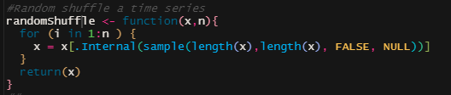
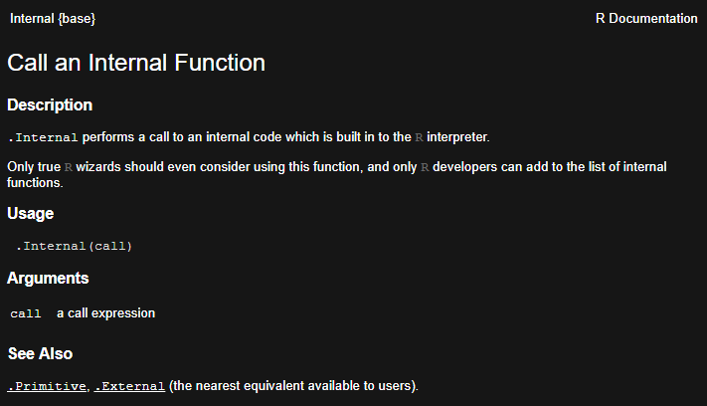
Attempt on shuffling time series
Using a randomShuffle function:

Slide 16
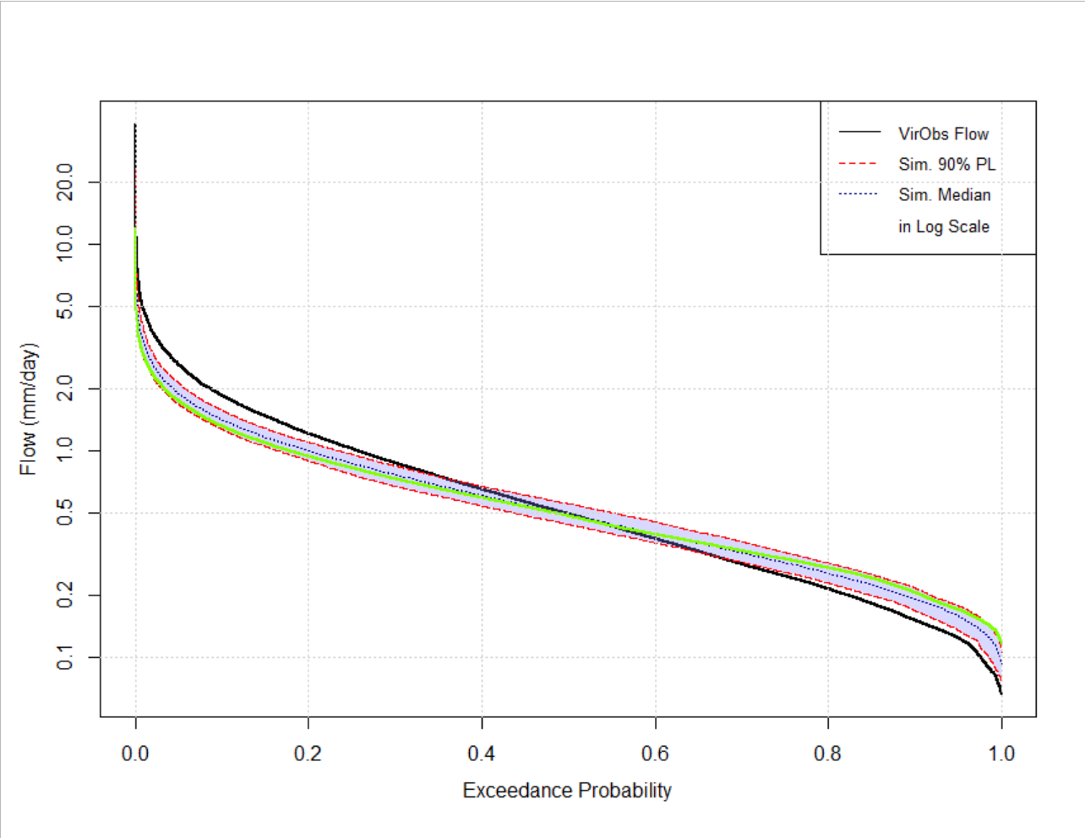
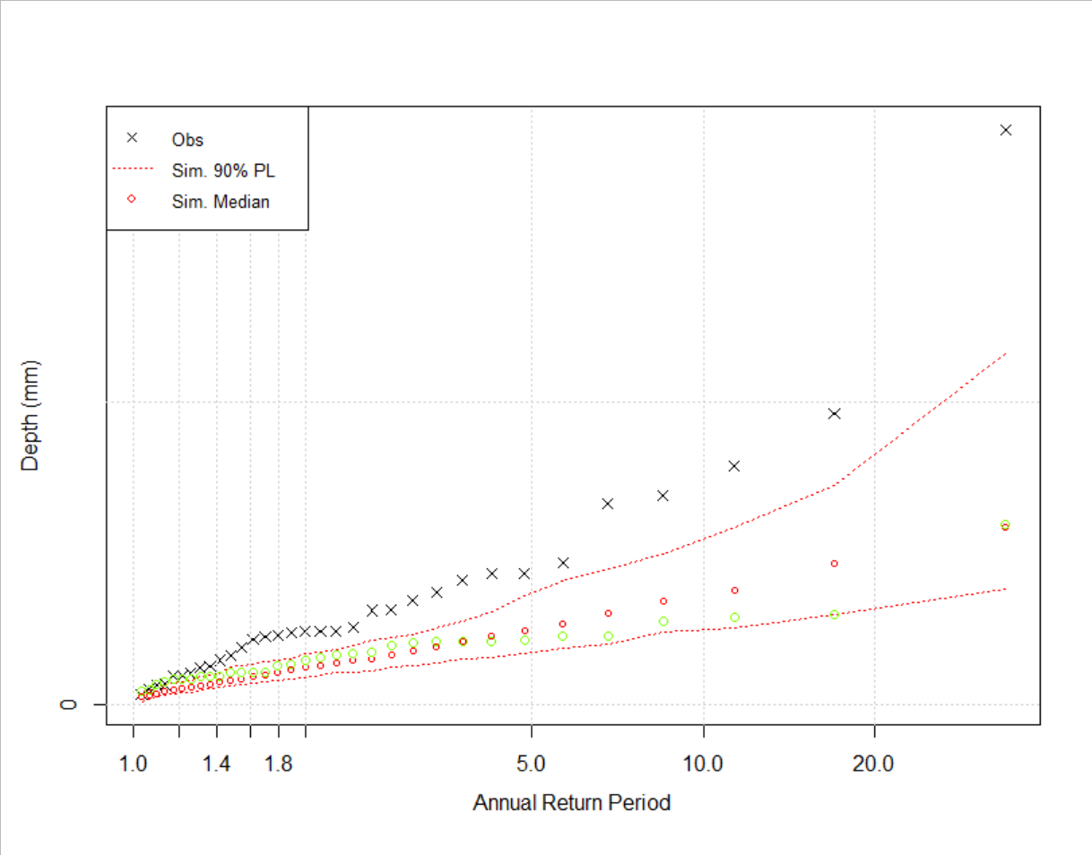
Attempt on shuffling time series
Shuffling each month 10 times

Slide 17
Plan and question
What are other options for the experiment with optimisation? (try different objective functions, setting different boundaries for the parameters, try other sites).
Pick 1 site and repeat the experiment with multiple raingauges surrounding the site
Starting on draft/skeleton for paper (starting with motivation)?
Suggestions to quantitatively assess models performance.
Looking into diagnostic metric experiments (e.g. continue with shuffling rainfall time series)

